Slide 1

GROUP-8

Slide 2





FARMER
MIDDLE-MAN
TRANSPORTER
CUSTOMER
SALES MAN

Slide 3




PROBLEMS
OLD FARMER
NO STABLE INCOME
UNUSED FARMING LAND

Slide 4
SOLUTION

Slide 5

FARMER
MIDDLE-MAN
TRANSPORTER
LALA BROTHERS

Slide 6


FIND THE UNUSED LAND
REGISTRATION
MONTHLY WAGES

Slide 7


PROVIDING DAILY WAGES
FARMER

Slide 8
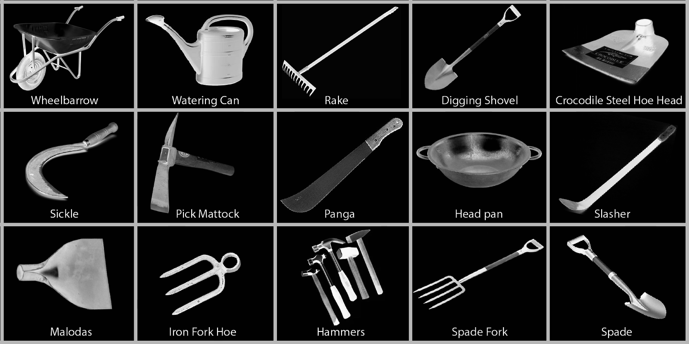

BENEFITS
STABLE INCOME
PROVIDING EQUIPMENT

Slide 9

MARKETING STRATEGIES

Slide 10



CAMPAIGN
TALKS
REFERRAL PROGRAMS
PAMPHLET

Slide 11


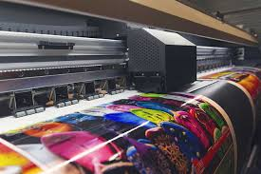
ADVERTISEMENT
BANNERS
WEBSITE ADS
SOCIAL MEDIA ADS

Slide 12



ONLINE PROMOTIONS
SOCIAL MEDIA PLATFORM
RUNNING ADS
SEO

Slide 13
THANK YOU

